Slide 1


NTSB • FAA
Aviation Accidents & incidents
NTSB , FAA
Dr : Dina Mohsen
Abdelshakour Adel
Osama Ahmed Abdelnazir
Mohammed Ihab
Basmala Mahmoud
Kirollos Godallah
AVIATION SAFETY • INVESTIGATION • DATA ANALYSIS
›

Slide 2
AVIATION SAFETY
Aviation Safety Fundamentals
Defining Accidents vs. Incidents
1
Accident
2
Incident
3
Primary Goal
An occurrence associated with the operation of an aircraft resulting in fatal injury, illness, or structural damage.
An event, other than an accident, affecting or affecting the safety of operation.
Modern aviation safety focuses on proactive risk reduction rather than assigning civil or criminal liability.
PROACTIVE RISK REDUCTION
‹
›

Slide 3
AGENCY ROLES
NTSB vs FAA: Key Roles
N
NTSB
F
FAA
Independent Investigator: Lead agency in investigating civil aviation accidents in the U.S.
No Regulatory Power:
Cannot issue fines or binding laws; focuses solely on determining probable cause and safety
Recommendations
Regulatory & Operational Body: Manages air traffic control, certifies pilots, and sets airworthiness standards.
Enforcement Mandate:
Can issue Airworthiness Directives (ADs), impose fines, or revoke certifications.
‹
›

Slide 4
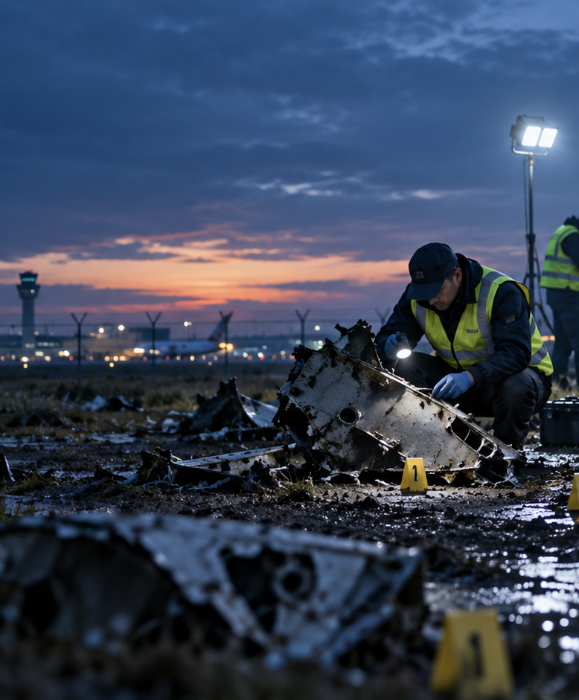
NTSB
NTSB: Independent Inquiries
The "Go Team" Deployment
Upon notification of a major crash, the NTSB deploys a multi- disciplinary "Go Team" consisting of experts in systems, engines, structures, and human performance.
Party system: Invites manufacturers and operators to provide technical assistance under strict NTSB supervision.
‹
›

Slide 5

FAA
FAA Operations & Oversight
Air Traffic Control: Manages over 45,000 daily flights across the National Airspace System ensuring safe separation.
1
Aircraft Certification: Sets rigorous design and airworthiness standards for manufacturers before flight operations.
2
Rulemaking Action: Enforces safety recommendations issued by the NTSB into legally binding mandatory rules.
3
‹
›

Slide 6

GLOBAL FRAMEWORK
ICAO & Global Aviation Services
1
2
3
ICAO Annex 13 Framework : Sets international protocols for crash investigation protocols worIdwide
Global Airline Standards : Harmonizing pilot training, crew resource management (CRM), and safety checks.
Cross-Border Support : Coordination between foreign authorities (e.g., BEA, AAIB) and NTSB/FAA.
‹
›

Slide 7
SAFETY METRICS
Aviation Safety Key Metrics
Continuous Improvements in Sky Safety
80%
Commercial aviation remains the safest mode of long-distance transportation worldwide.
over the last four decades
Due to rigorous NTSB inquiries and FAA mandates, commercial airliner fatal accident rates have dropped by over 80% over the last four decades.
Continuous Improvements in Sky Safety
‹
›

Slide 8
INVESTIGATION
Accident Investigation Steps
1
Site Securing
2
Data Recovery
3
Fact Analysis
4
Final Report
Immediate site securing, wreckage preservation & search for black boxes.
Extracting FDR and CVR flight recorder telemetry and audio.
Testing components, metallurgy, human factors & weather analysis.
Determining probable cause and issuing recommendations.
‹
›

Slide 9
SEVERITY
Accident Severity Classes
Primary Objective/ GoalCla | Resources Assigned | Investigation Focus | Class Level
In-depth probable cause & systemic safety fixes | Full NTSB Go Team + Industry Parties. | Major transport airliner crashes with fatal casualties. | Class 1
Identify safety factors & recurring failure trends. | Senior Regional Investigator led team. | Significant accidents involving notable damage/injuries. | Class 2
Develop preventative industry safety messages | Specialized Subject Matter Experts | Incidents revealing specific underlying risk issues. | Class 3
Quick factual reporting within 6 months. | Single Investigator (mostly remote) | Limited-scope general aviation incidents | Class 4
Primary Objective/ GoalCla
Resources Assigned
Investigation Focus
Class Level
Class 1
Class 2
Class 3
Class 4
‹
›

Slide 10
PYTHON DATA ANALYSIS
Python Data Analysis – Airline Accidents Dataset
1. Data Loading
2. Data Cleaning
3. Data Type Conversion
I loaded the airline accidents dataset using Pandas and checked its shape, columns, and sample records to understand the dataset before starting the cleaning process.
I cleaned the text columns by removing extra spaces and converting blank values and common missing-value placeholders such as "NA", "N/A", "None", and "null" into proper missing values.
I converted date columns into DateTime format and numeric columns such as injuries, coordinates, and number of engines into numeric data types to make the data easier to analyze.
4. Injury Data Cleaning
5. Text Standardization
I checked the injury columns for invalid negative values and corrected missing fatal injury values based on the "Injury Severity" column.
For example, values such as "Fatal(3)" were matched with "3" fatal injuries, while non-fatal records with missing fatal injuries were set to "0".
I standardized inconsistent values across the dataset.
For example, different forms of "Unknown" were unified, weather abbreviations such as "VMC" and "IMC" were expanded, and common aircraft manufacturer abbreviations were standardized.
‹
›

Slide 11
PYTHON DATA ANALYSIS
Python Data Analysis – Airline Accidents Dataset
6. Validation
7. Feature Engineering
8. Missing Value Treatment
I validated important numeric values by checking that latitude and longitude were within valid geographic ranges and that the number of engines was a valid whole number.
I created a new "Total Injuries" column by adding fatal, serious, and minor injuries for each record.
I handled missing values based on the meaning of each column instead of applying the same method to all columns.
"Aircraft Damage" → Missing values were replaced with "Unknown".
"Location" → Missing values were replaced with "Unknown".
"Investigation Type" → Missing values were replaced with "Unknown" because the number of missing values was very high, so using the Mode could distort the original distribution.
"Engine Type" → Missing values were kept as "Unknown".
"Weather Condition" → Missing values were kept as "Unknown".
"Model" → Different forms such as "UNKNOWN" and "UNK" were standardized to "Unknown".
"Purpose of Flight" → "Unknown" and missing values were replaced using the Mode.
"FAR Description" → "Unknown" and missing values were replaced using the Mode.
"Make" → "Unknown" and missing values were replaced using the Mode.
"Broad Phase of Flight" → "Unknown" values were converted to "Other".
"Number of Engines" → Missing values were handled using the Median, and zero values were replaced with the rounded Mean of the positive values.
"Total Injuries" and injury columns → Missing values were replaced with "0".
"Report Publication Date" → Missing dates were labeled as "Not Recorded".
‹
›

Slide 12
PYTHON DATA ANALYSIS
Python Data Analysis – Airline Accidents Dataset
9. Event Date Treatment
10. Duplicate Removal
11. Outlier Analysis
There were only 7 records with missing "Event Date".
Since the exact date could not be reliably determined, these 7 records were removed because the event date is important for time-based analysis.
I checked for duplicate records and removed exact duplicate rows to avoid counting the same accident more than once.
I used the IQR method to detect statistical outliers in the injury columns.
The detected outliers were kept because they can represent real and valid accident events rather than data-entry errors.
12. Encoding
13. Normalization
I applied One-Hot Encoding to categorical columns such as "Investigation Type", "Weather Condition", "Amateur Built", "Engine Type", "Purpose of Flight", and "Broad Phase of Flight" to make them suitable for machine learning and numerical analysis.
I applied Min-Max Normalization to numerical features such as coordinates, number of engines, and injury counts so that the values were placed on a similar scale.
‹
›

Slide 13
PYTHON DATA ANALYSIS
Python Data Analysis – Airline Accidents Dataset
14. Data Visualization
15. Final Dataset
I created several visualizations to understand patterns in the dataset:
After cleaning, validation, missing-value treatment, and duplicate removal, the dataset was saved as a new cleaned CSV file ready for further analysis and visualization.
1
Investigation Type distribution
2
Top 10 aircraft manufacturers
3
Weather Condition distribution
4
Aircraft accidents over time
5
Geographic distribution of accident locations.
CLEANED CSV • READY
‹
›

Slide 14
DASHBOARD 1
Dashboard 1 — Safety Trends Overview
1
How has the number of accidents changed year over year?
2
What percentage of accidents result in fatal injuries vs non-fatal?
3
What is the trend in total fatalities per year?
4
Which years had the highest number of "Uninjured" outcomes (survivability trend)?
5
What is the ratio of "Accident" vs "Incident" investigation types over time?
6
How many accidents were reported with a significant delay between event date and report publication date?
7
What is the average number of total injuries per accident by year?
‹
›

Slide 15
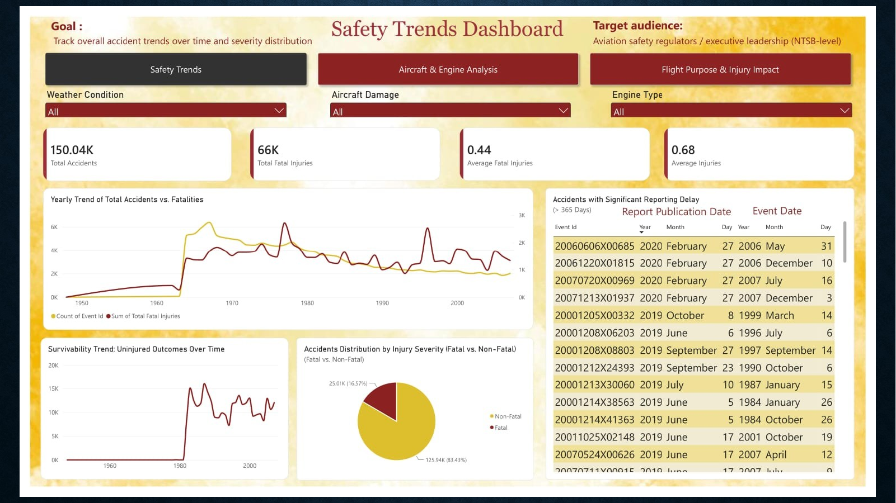
DASHBOARD VIEW
Dashboard 1 — Safety Trends Overview
‹
›

Slide 16
DASHBOARD 2
Dashboard 2 — Geographic & Environmental Risk
1
Which countries have the highest number of accidents?
2
Which specific airports have the highest accident frequency?
3
What percentage of accidents occurred under VMC vs IMC weather conditions?
4
Is there a correlation between weather condition (IMC) and fatal injury severity?
5
Which US states/locations show the highest accident concentration?
6
What is the average fatality count for accidents occurring in poor weather vs good weather?
7
Which broad phase of flight (takeoff, landing, cruise, maneuvering) has the highest accident rate per country?
‹
›

Slide 17
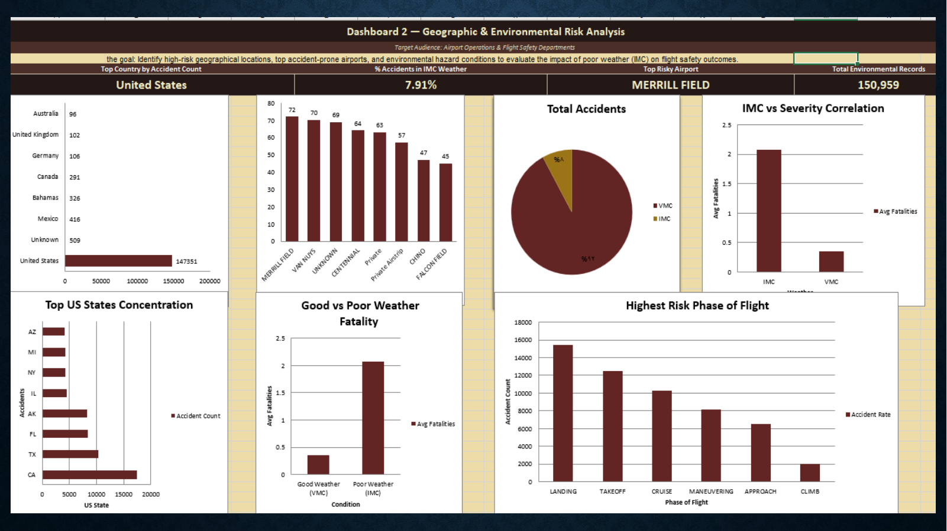
DASHBOARD VIEW
Dashboard 2 — Geographic & Environmental Risk
‹
›

Slide 18
DASHBOARD 3
Dashboard 3 — Aircraft & Engine Analysis
1
Which aircraft manufacturers (Make) have the highest number of recorded accidents?
2
Which specific aircraft models appear most frequently in fatal accidents?
3
What percentage of accidents involve amateur-built aircraft vs certified aircraft?
4
Is there a relationship between number of engines and severity of aircraft damage?
5
Which engine type (Reciprocating, Turbine, etc.) has the highest fatality rate?
6
What is the distribution of "Aircraft Damage" severity (Destroyed/Substantial/Minor) by manufacturer?
7
Do amateur-built aircraft show a higher fatal injury rate compared to standard aircraft?
‹
›

Slide 19
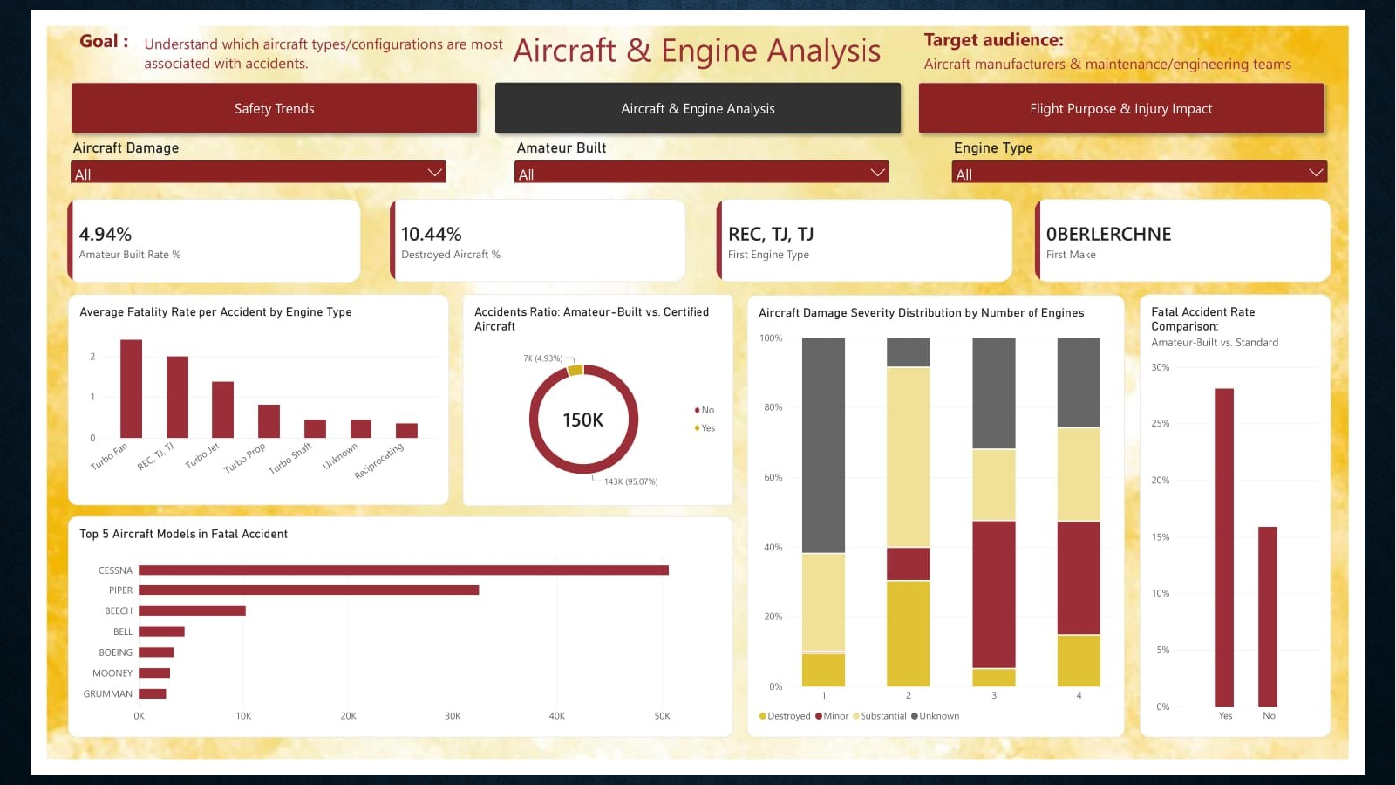
DASHBOARD VIEW
Dashboard 3 — Aircraft & Engine Analysis
‹
›

Slide 20
DASHBOARD 4
Dashboard 4 — Flight Purpose & Injury Impact
1
Which "Purpose of Flight" categories (Personal, Instructional, Commercial, etc.) have the highest accident counts?
2
Which flight purpose has the highest fatality rate?
3
What is the average number of serious injuries per accident by flight purpose?
4
Is there a difference in injury severity between instructional and personal flights?
5
Which flight purpose category has the highest number of "Uninjured" outcomes?
6
What is the total injury count (fatal + serious + minor) broken down by FAR Description (Part 91, Part 121, etc.)?
7
Which regulatory part (FAR Description) is associated with the most fatal accidents?
‹
›

Slide 21
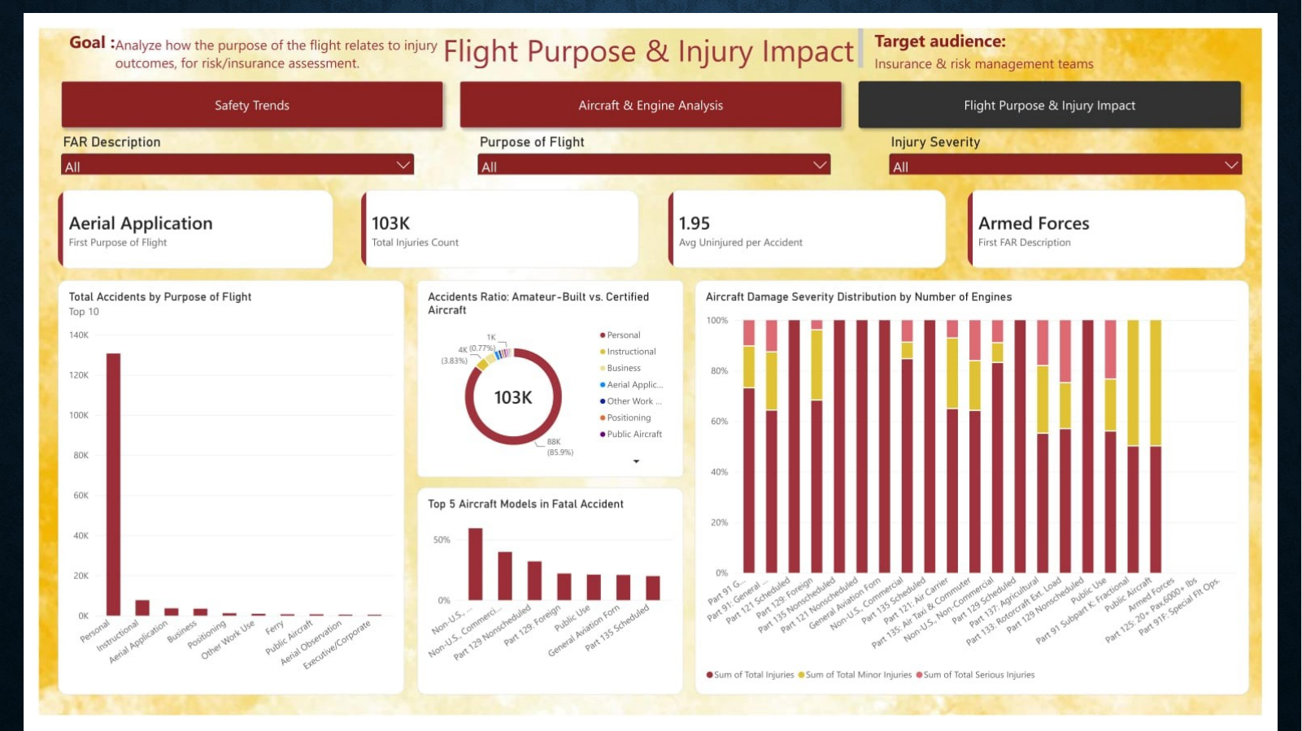
DASHBOARD VIEW
Dashboard 4 — Flight Purpose & Injury Impact
‹
›

Slide 22

FINAL
Thank you!
‹

